Slide 1
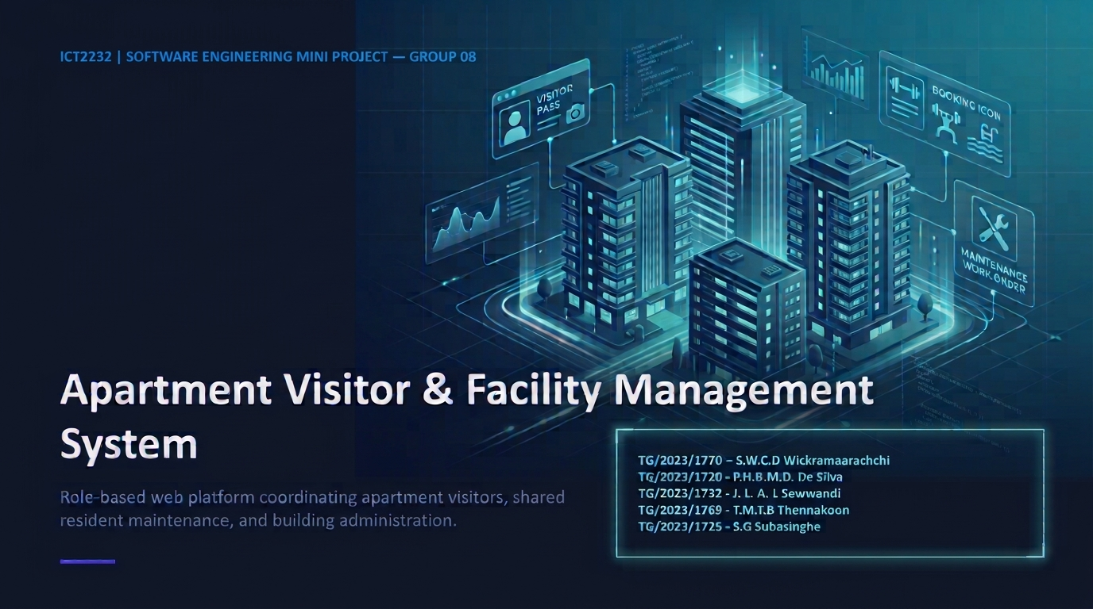

ICT2232 | SOFTWARE ENGINEERING MINI PROJECT — GROUP 08
Apartment Visitor & Facility Management System
Role-based web platform coordinating apartment visitors, shared amenities, resident maintenance, and building administration.
TG/2023/1770 - S.W.C.D Wickramaarachchi
TG/2023/1720 - P.H.B.M.D. De Silva
TG/2023/1732 - J. L. A. L Sewwandi
TG/2023/1769 - T.M.T.B Thennakoon
TG/2023/1725 - S.G Subasinghe

Slide 2
01 / PROBLEM & STAKEHOLDERS
Replacing Manual Logs With Digital Workflows
Manual Process Pain Points
Target Role Portals
Paper Logbooks: Unverified gate visitor entries.
Residents: Pre-register guests, book slots, log issues.
Booking Conflicts: Double-booked shared facilities.
Security Staff: Verify arrivals, log walk-in check-ins.
Opaque Maintenance: Zero service status tracking.
Administrators: Manage flats, staff, operational statuses.
Fragmented Records: No unified management audit view.
Data Isolation: Strict flat-level privacy boundaries.

Slide 3
02 / AGILE PROCESS & PLANNING
Iterative 4-Sprint Delivery Roadmap
SPRINT 01
SPRINT 02
SPRINT 03
SPRINT 04
Foundation & Auth
Resident Workflows
Security & Admin
QA & Maintenance
Laravel 12 setup, Breeze auth, OAuth, 13 migrations.
Visitor pre-registration, facility booking, service requests.
Walk-in gate control, check-in/out, flat management.
CR-01 privacy fix, 36 PHPUnit tests, XAMPP rollout.

Slide 4
03 / REQUIREMENTS ENGINEERING
Prioritized Requirements & User Story Baseline
12
6
10
7
Functional Requirements
Non-Functional Specs
Agile User Stories
Core Use Cases
FR-01 to FR-12 (MoSCoW)
Security, Privacy, Reliability
US-01 to US-10 with Criteria
End-to-End Traceability

Slide 5

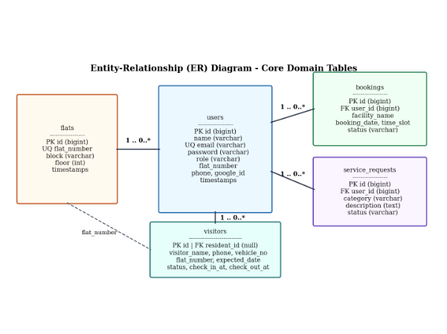
04 / SYSTEM ARCHITECTURE & DATA MODEL
Three-Tier Laravel 12 MVC & Relational Schema
Presentation Tier: Server-rendered Blade templates, Tailwind CSS utility styling, and Alpine.js interactivity.
Application Tier: Role-aware controllers (Resident, Visitor, Admin) with server-side validation.
Persistence Tier: 13 reversible migrations across 5 core domain tables in MariaDB 10.4.

Slide 6

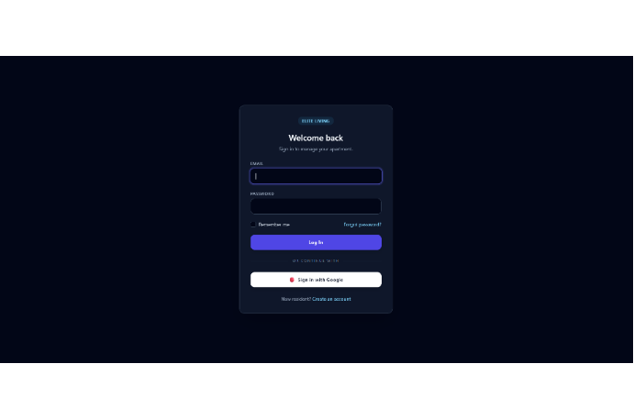
05 / AUTHENTICATION & ACCESS CONTROL
Multi-Role Sign-In & Google OAuth 2.0 Portal
Laravel Breeze + Socialite: Supports standard email/password login and one-click Google OAuth 2.0 authentication.
Role-Aware Redirection: Automatically routes users to /resident, /security, or /admin dashboards.
Session Protection: Bcrypt password hashing, rate-limited login throttling, and CSRF token verification.

Slide 7

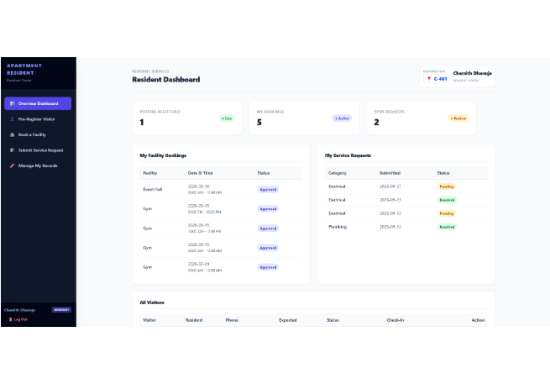
06 / RESIDENT WORKFLOWS
Resident Portal: Visitors, Bookings & Maintenance
Visitor Pre-Registration: Pre-approve expected guests linked to assigned flat (e.g., Flat C-401).
Conflict-Free Facility Booking: Reserve Event Hall, Gym, or Pool with real-time slot verification.
Service Request Tracking: Submit Electrical or Plumbing issues and monitor live resolution status.

Slide 8

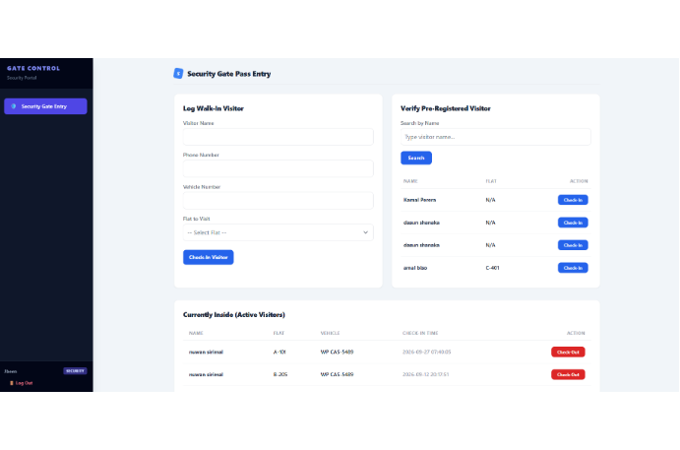
07 / SECURITY GATE OPERATIONS
Gate Control: Walk-In Logging & Check-In/Out
Walk-In Visitor Capture: Records visitor name, phone, vehicle number, and validates flat existence.
Expected Guest Verification: Instant search by visitor name with one-click Check-In button.
Active Visitor Monitoring: Tracks visitors currently inside with timestamped Check-Out actions.

Slide 9
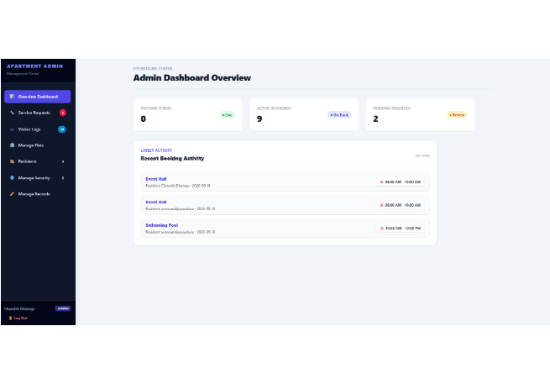
08 / BUILDING ADMINISTRATION
Admin Operations Center & Resource Control
Live Operational KPIs: Real-time counters for Visitors Today, Active Bookings, and Pending Requests.
Flat Catalogue Guard: Create or remove apartment flats while blocking deletion of occupied units.
Account & Status Governance: Provision security staff accounts and update booking/service statuses.

Slide 10
09 / QUALITY ASSURANCE & MAINTENANCE (CR-01)
Automated PHPUnit Verification & CR-01 Resolution
36 / 36
100% Automated Test Suite Passing (104 Assertions on In-Memory SQLite)
Implemented Maintenance Change Request CR-01 to enforce strict resident visitor query isolation and align role-aware login redirect assertions.

Slide 11
10 / SECURITY CONTROLS & TEAMWORK
Individual SDLC Contributions & Security Baseline
Team Member | Assigned Module | Core SDLC & Security Deliverable
S.W.C.D Wickramaarachchi | Resident Dashboard | Visitor pre-registration, slot conflict check, tenant IDOR isolation
P.H.B.M.D. De Silva | Admin Dashboard | KPI analytics, flat delete guard, booking & service status control
J. L. A. L Sewwandi | Security Dashboard | Walk-in visitor validation, expected guest search, check-in/out audit
T.M.T.B Thennakoon | Login & Authentication | Breeze auth, Google OAuth 2.0, RBAC middleware, rate-limiting
S.G Subasinghe | Database & Backend | 13 MariaDB migrations, Eloquent models, 36 PHPUnit test suite
Go to Apartment system site
https://ict-2232-apartment-management-syste.vercel.app/?_vercel_share=8QAlKYVeqZbRAIoysrielckuobZTp6GM

Slide 12

ICT2232 MINI PROJECT — FINAL EVALUATION & VIVA
Thank You & Q&A

